Slide 1
DUGGIRALA VENKATA SURYA
Final project

Slide 2


AGENDA
Introduction on keylogger
Types of keylogger
Understanding the problem statement
Overview of the project
Prevention techniques
The end users in project
Solution and value proposition
Modelling
Result
3/21/2024 Annual Review

Slide 3
KEYLOGGER
A keylogger (or keystroke logger) is a type of spyware that monitors and records what you type on your computer or mobile phone. Keylogging software or hardware can be used to monitor activity for legal or illegal purposes. Keyloggers work by recording the interactions a user has with their keyboard, allowing someone to access a log of every email, instant message, search query, password, username, or other keyed sequences that a user types.

Slide 4
TYPES OF KEYLOGGER
1.Software keylogger
2.Hardware keylogger
1.Software keylogger
In cybersecurity a software keylogger is a type of malicious software (malware) designed to monitor and record keystrokes made on a computer or mobile device. This information is typically captured covertly and can include sensitive data such as passwords, credit card numbers, and other personal information. The collected keystrokes are often transmitted to the attacker or stored locally for later retrieval. Software keyloggers are particularly dangerous because they can be installed without the user's knowledge, often through phishing attacks, malicious downloads or as part of other malware packages.

Slide 5
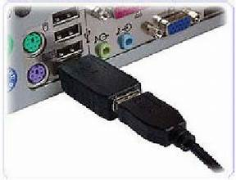
2.Hardware keylogger
In cybersecurity, a hardware keylogger is a physical device used to monitor and record keystrokes made on a keyboard. Unlike software keyloggers, hardware keyloggers do not rely on any software installation or manipulation of the computer's operating system. Instead, they intercept the electrical signals from the keyboard to the computer, capturing each keystroke. They are often used in targeted attacks where physical access to the device is possible, such as in corporate espionage or ATM skimming.

Slide 6

PROBLEM STATEMENT
Keyloggers are type of malware that can steal sensitive information from device such as passwords , card numbers, messages. If this data falls into the wrong hands, it can lead to serious consequences, including identity theft, financial loss, and fraud. The increasing prevalence of keyloggers poses a significant threat to digital security, compromising the confidentiality and integrity of sensitive information.
Keyloggers pose a threat to the security of an organization’s sensitive data and systems. When sensitive data such as passwords is typed into a computer, there are no protections in place preventing it from being collected by malware. A keylogger can steal sensitive data that can be used for various purposes effects the personal details of the individuals, financial loss, identity thefts
They are challenging to create. They require knowledge of how keyboards function. They are quite difficult to detect and remove, especially by user-space applications. They have an opportunity to get access to all keyboard data as it travels to the OS. Activity logs may be accessed remotely over the Internet, from a safe distance

Slide 7

PROJECT OVERVIEW
This project aims to address the critical need for effective detection and prevention methods against keyloggers. It will explore the current landscape of keylogger technology, evaluate existing security measures, and develop innovative solutions to enhance protection against these threats. By doing so, the project seeks to mitigate the risks associated with keyloggers, safeguard personal and organizational data, and promote a secure digital environment.
Securing your internet is of paramount importance in today’s digital world. In an age where personal information and financial data are often stored online, the need to understand different cybersecurity threats and how to protect against them cannot be overstated. One particular threat is a keylogger, a malicious program designed to track and record every keystroke on a computer or mobile device, thereby gaining unauthorized access to personal data. This guide aims to provide you with an in-depth understanding of what a keylogger is how they work and the various ways you can protect yourself from this insidious
keylogger, short for keystroke logger, is a type of cyber threat that records the keys struck on a keyboard, typically covertly, so the person using the keyboard is unaware that their actions are being monitored. This enables attackers to gain unauthorized access to confidential information, such as passwords, credit card numbers, and other sensitive data, which can then be used for identity theft, financial fraud, and other forms of cybercrime.
3/21/2024 Annual Review

Slide 8
PREVENTION TECHNIQUES
Using Virtual Keyboards: Reduces the risk of keystrokes being logged.
Regular Software Updates: Ensures that security patches are applied.
Strong Endpoint Security: Includes firewalls, antivirus, and anti-spyware programs.
User Education: Teaching users about phishing and safe browsing practices.
Two-Factor Authentication (2FA): Adds an additional layer of security beyond passwords.

Slide 9

WHO ARE THE END USERS?
Keyloggers, also known as keystroke loggers or system monitors, can have many end users, including individuals, businesses, and government . Even Parents can use keyloggers to monitor their children's online activities, such as screen time, WhatsApp interactions, call logs, and location. The major end users are:
Employers: can use keyloggers to monitor employee productivity and behavior, especially in remote work environments. This can help ensure employees adhere to company policies, such as cybersecurity and data leak prevention.
Information technology departments :can use keyloggers to troubleshoot issues on a device.
Security professionals and ethical hackers :can use keyloggers to identify vulnerabilities in computer systems and networks.
Cybercriminals: can use keyloggers to steal sensitive information, such as passwords, credit card numbers, and personal data. This information can be used for identity theft, financial fraud, or other criminal activities.
3/21/2024 Annual Review

Slide 10

YOUR SOLUTION AND ITS VALUE PROPOSITION
Anti-Key-logger – As the name suggest these are the software which are anti / against key loggers and main task is to detect key-logger from a computer system.
Anti-Virus – Many anti-virus software also detect key loggers and delete them from the computer system. These are software anti-software so these can not get rid from the hardware key-loggers.
Automatic form filler – This technique can be used by the user to not fill forms on regular bases instead use automatic form filler which will give a shield against key-loggers as keys will not be pressed .
One-Time-Passwords – Using OTP’s as password may be safe as every time we login we have to use a new password.
Patterns or mouse-recognition – On android devices used pattern as a password of applications and on PC use mouse recognition, mouse program uses mouse gestures instead of stylus.
Voice to Text Converter – This software helps to prevent Keylogging which targets a specific part of our keyboard.

Slide 11

THE WOW IN YOUR SOLUTION
Revolutionary AI-Powered Detection: Our solution utilizes cutting-edge artificial intelligence (AI) algorithms to detect and prevent keylogger threats with unprecedented accuracy and efficiency. By continuously analyzing user behavior patterns and keystroke dynamics, our AI-driven system can identify even the most sophisticated keyloggers in real-time, providing proactive protection against evolving threats.
Predictive Behavioral Analysis and Auto-Remediation: Our solution harnesses the power of predictive behavioral analysis to anticipate and preemptively neutralize keylogger threats. By analyzing user behavior patterns and device interactions in real-time, our system can accurately predict when a keylogger is attempting to compromise the system.
11

Slide 12
MODELLING
Import Required Modules:
Use Python's keyboard module to capture keystrokes.
Optionally, use other modules for logging, encryption, or network communication.
Set Up Logging:
Configure logging settings to specify the format and destination of log files.
Define Keylogger Function:
Create a function to capture and log keystrokes.
Use the keyboard.on_press() method to register a callback function to capture each key press event.
Main Function:
Create a main function to start the keylogger and keep it running indefinitely.
Testing and Deployment:
Test the keylogger program to ensure it captures keystrokes correctly.
Deploy the keylogger on target systems if necessary, ensuring compliance with legal and ethical considerations.
12

Slide 13
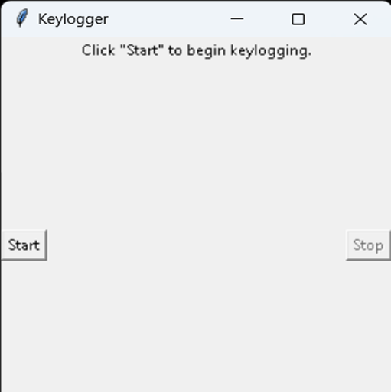
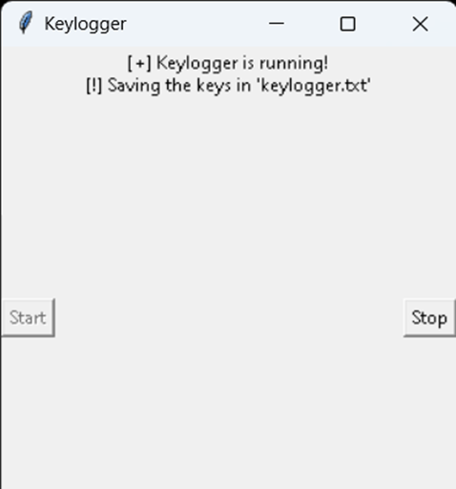
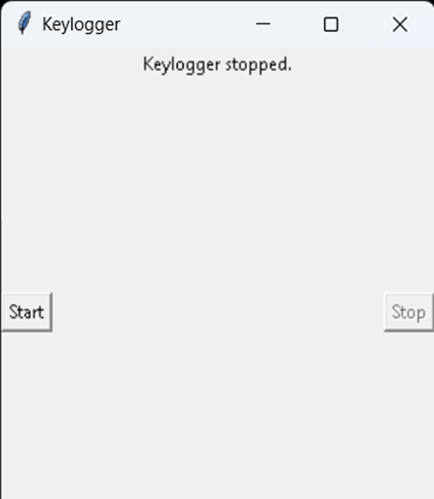
RESULTS
The result of a keylogger program typically involves capturing and logging keystrokes entered by a user on a keyboard. These logged keystrokes can then be used for various purposes, depending on the intent of the keylogger user. The covert nature of keyloggers allows them to capture sensitive information, including passwords, personal messages, and financial details, without the user's knowledge or consent. This poses serious risks to individuals, organizations, and society at large, including identity theft, financial fraud, and unauthorized access to confidential data.
13

